Slide 1


Test Automation Using Selenium
Fair Hike Academy
That’s the way the cookie crumbles!
Session 15: Data Driven Test using Excel Poi Framework
Mentor : Naresh Vulli, CSTE, PAHM.
fairhike@gmail.com www.fairhike.blogspot.com | www.facebook.com/fairhike

Slide 2
Today’s Topics
Recap
Poi Library setup
Poi Interfaces
Reading and writing data to Excel
Data driven Test
Takeaways or Exercise

Slide 3
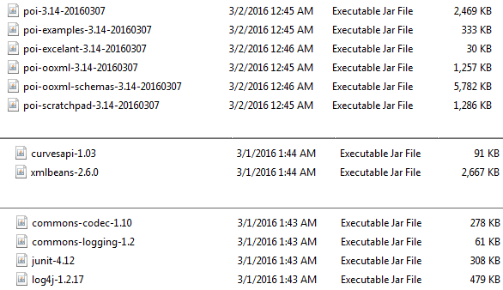
poi Library
https://poi.apache.org/download.html
poi-bin-3.14.zip (27MB, signed)
Download and Unzip the contents – add below Jar files to BuildPath
ooxml-lib Folder
Lib Folder

Slide 4
poi Interfaces for MS Excel
.xls - import org.apache.poi.hssf
.xlsx - import org.apache.poi.xssf
Work book
import org.apache.poi.hssf.usermodel.HSSFWorkbook;
import org.apache.poi.xssf.usermodel.XSSFWorkbook;
Worksheet
import org.apache.poi.hssf.usermodel.HSSFSheet;
import org.apache.poi.xssf.usermodel.XSSFSheet;
Row and cell
import org.apache.poi.ss.usermodel.Row;
import org.apache.poi.ss.usermodel.Cell;

Slide 5
Read and write Data to Excel
Read Data
datasheet.getRow(rowNum).getCell(colNum).getStringCellValue();
datasheet.getRow(rowNum).getCell(colNum).getNumericCellValue();
Write Data
datasheet.getRow(rowNum).getCell(colNum).setCellValue(<value>);
# of rows
datasheet.getLastRowNum()

Slide 6
Data Driven Tests using Excel
No hard coded values
Data maintenance is separated from script maintenance
Repeatable tests
Capture results in a storage file

Slide 7
Takeaway or Exercise
Write a data driven test to signup for gmail
https://accounts.google.com/SignUp

Slide 8
Q & A

Slide 9
Thank You ☺

